Slide 1
Breakneck
Wireless & Mobile networks – Final PRESENTATION
Earable based gesture recognition system
Presented by:
Murtaza Mister
Eshwar chaItanya Sarampati

Slide 2


AGENDA
Introduction
methodology
Dataset & experiments
conclusion

Slide 3
Introduction

Slide 4
Methodology
DTW
Dynamic time warping, to eliminate the time and speed differences across various individuals
Issues?
Change of orientation is not an issue.

Slide 5
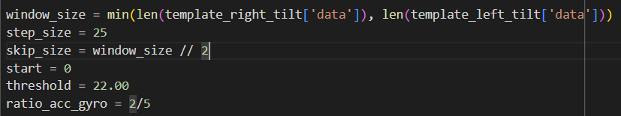
System parameters

Slide 6
Dataset & verifications

Slide 7
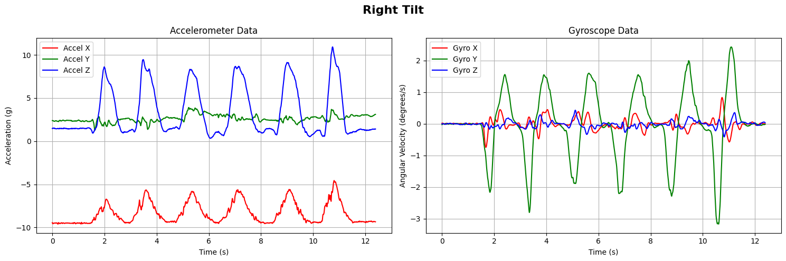
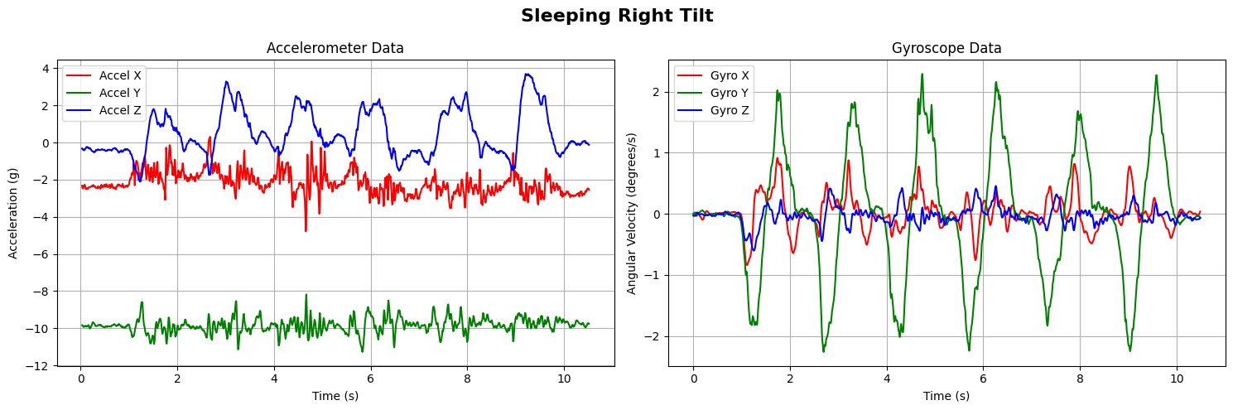
Type of data

Slide 8
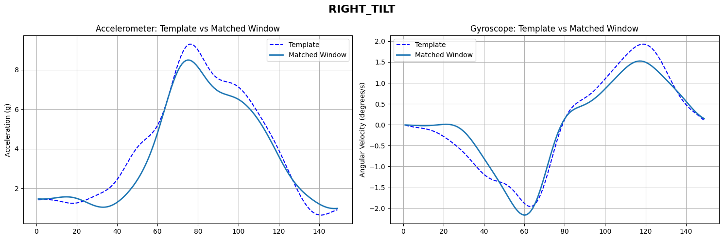
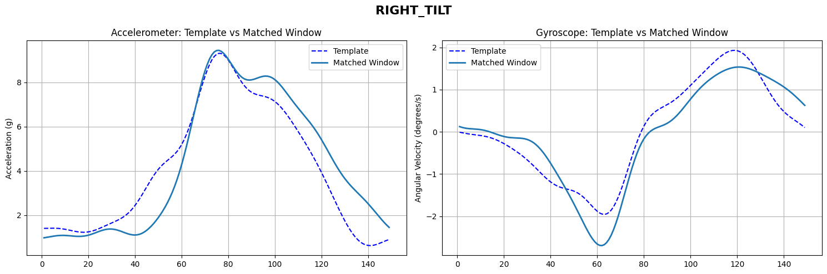
Right tilts

Slide 9
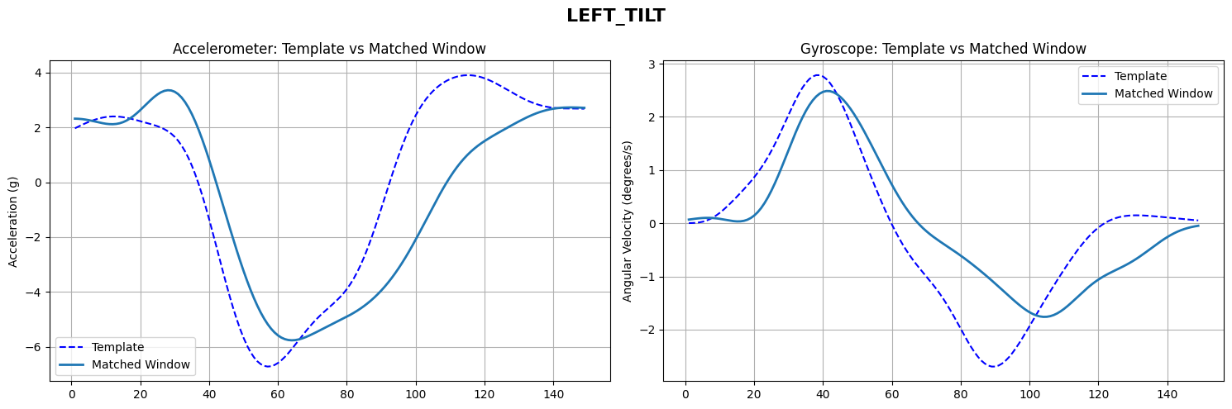
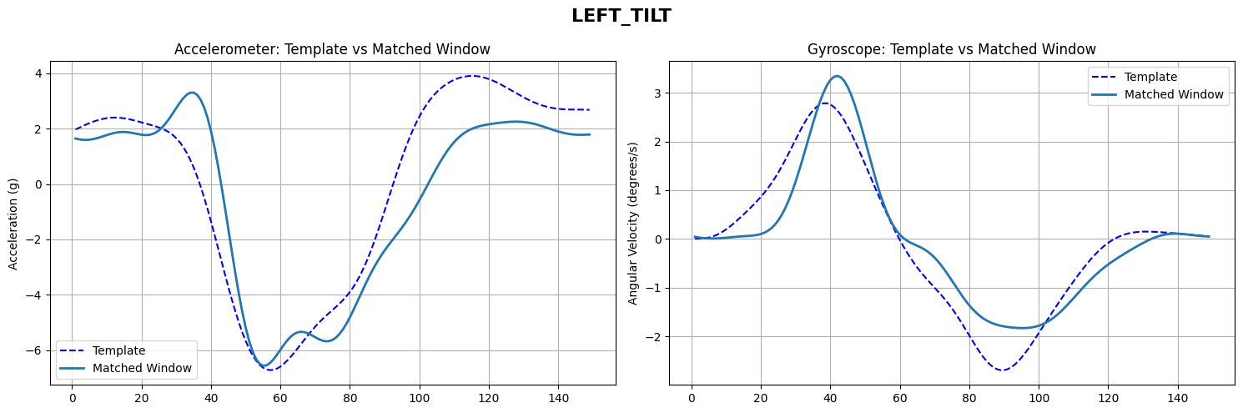
Left tilts

Slide 10
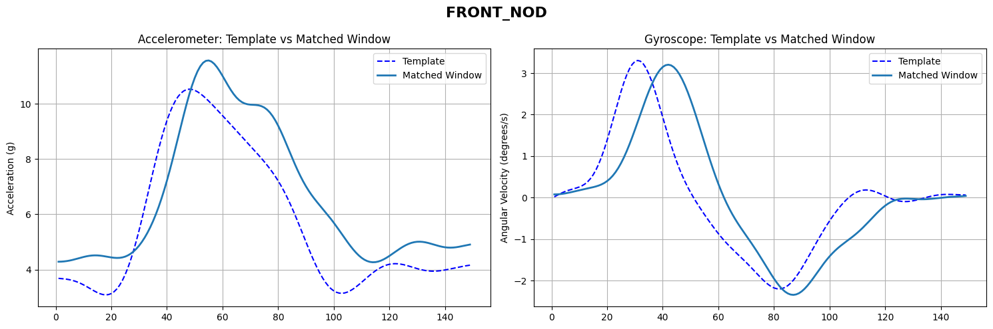
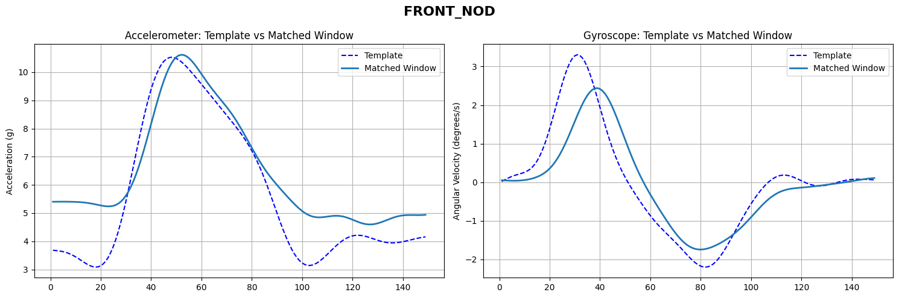
Front nod

Slide 11
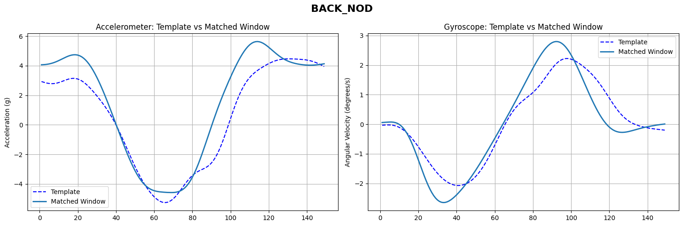
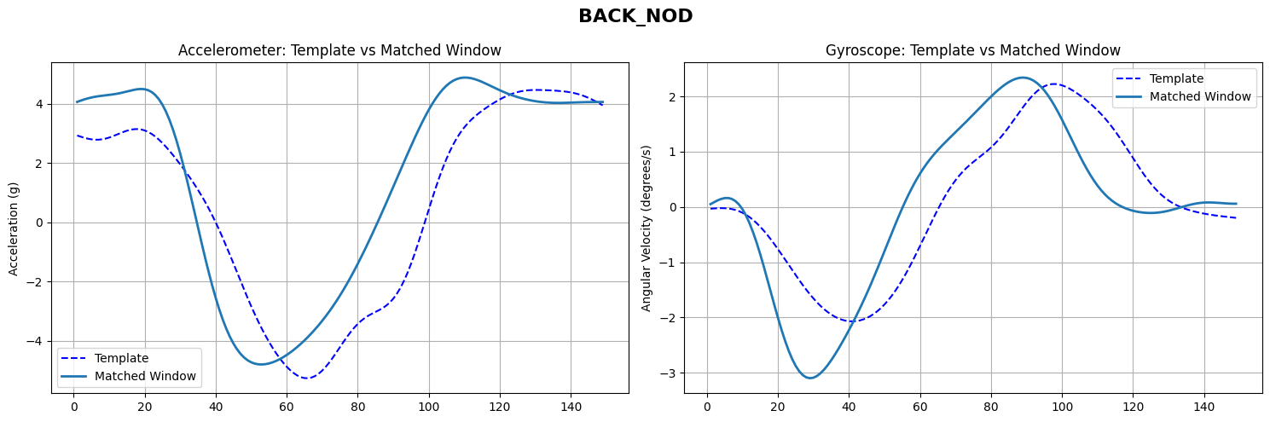
Back nod

Slide 12
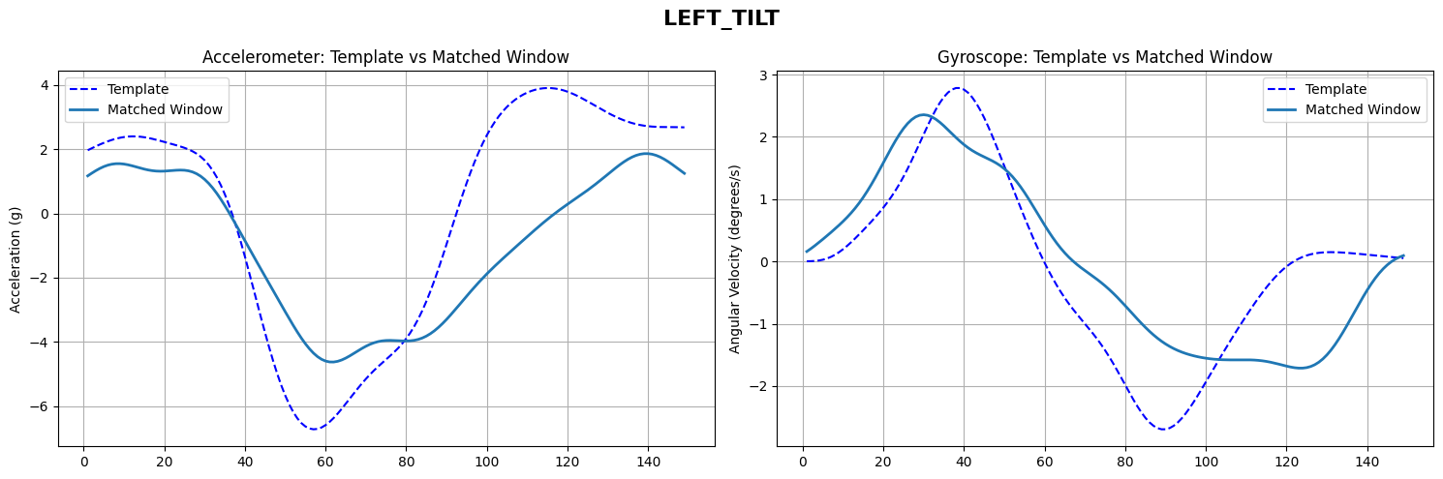
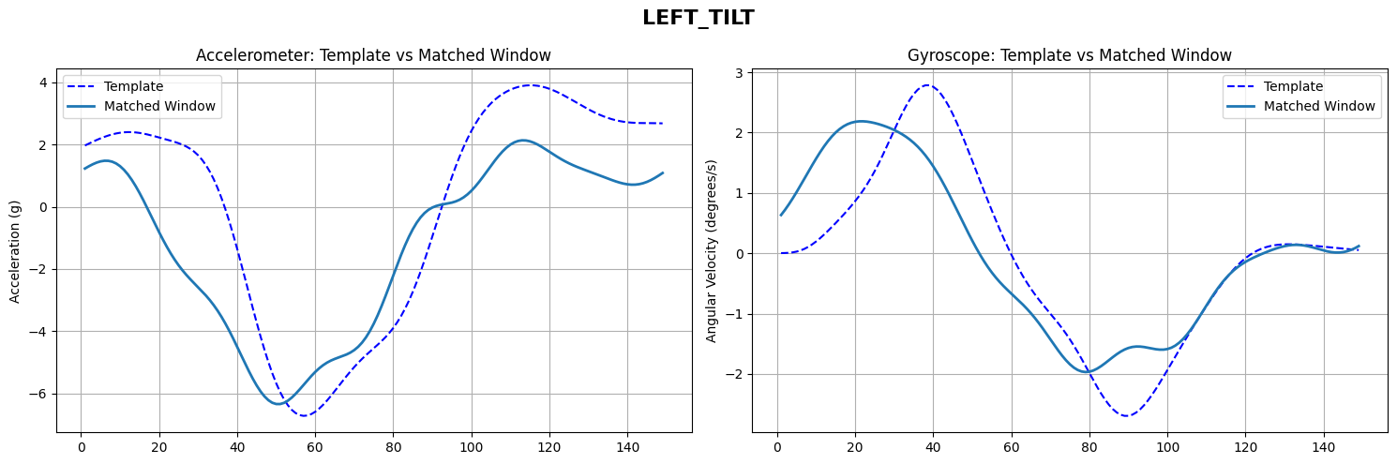
Sleeping left tilt

Slide 13
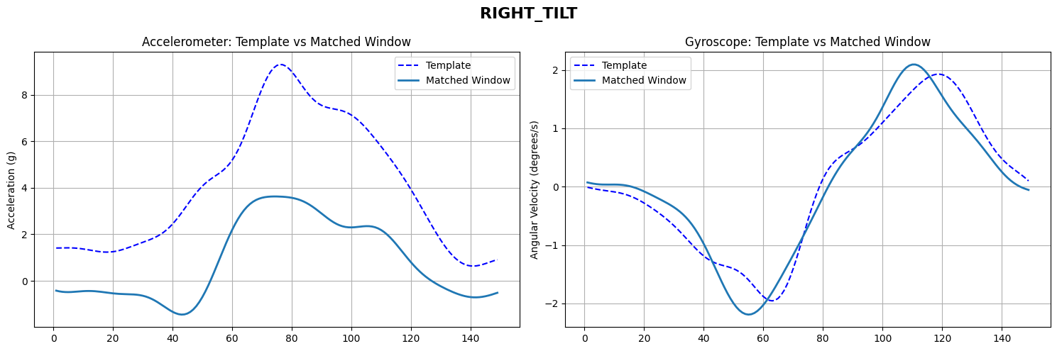
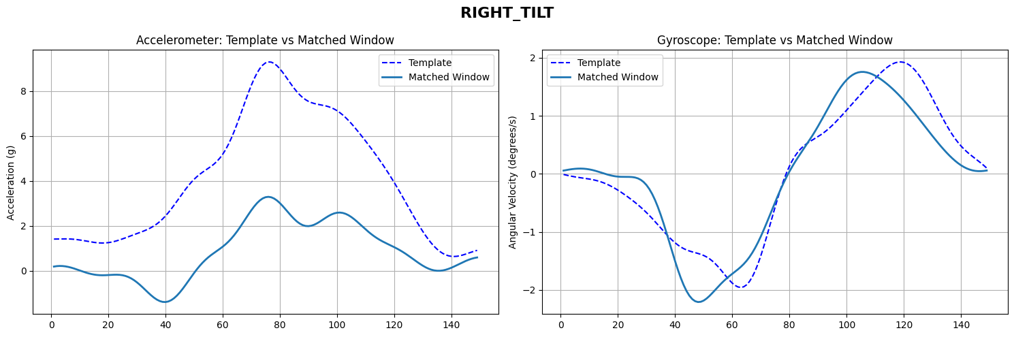
Sleeping Right tilt

Slide 14
Experiments

Slide 15
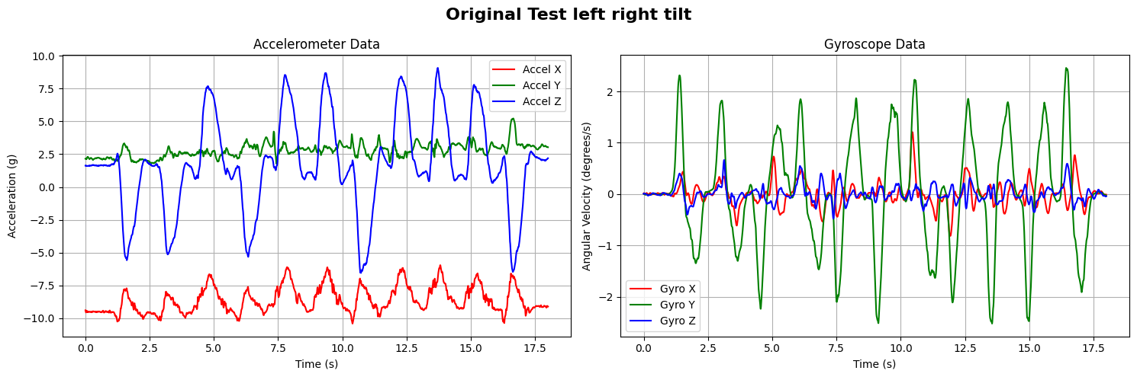
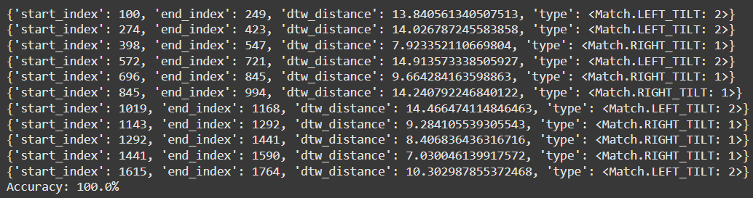
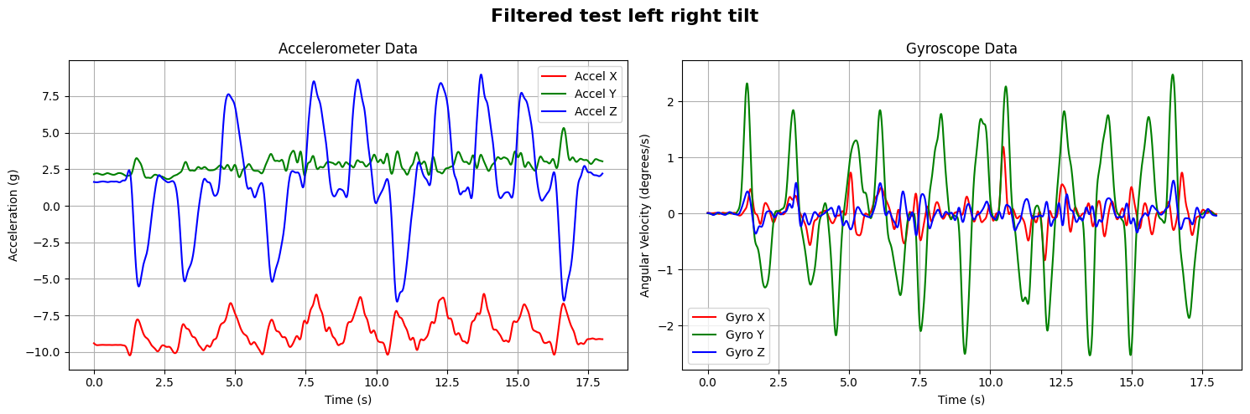
Left-right while sitting

Slide 16
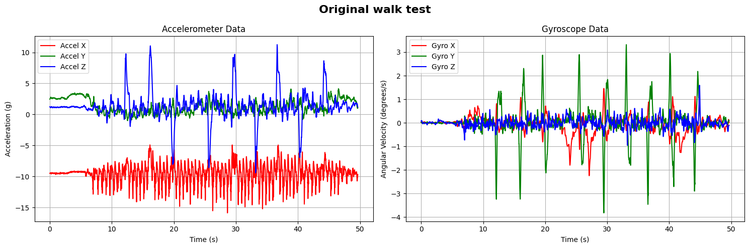
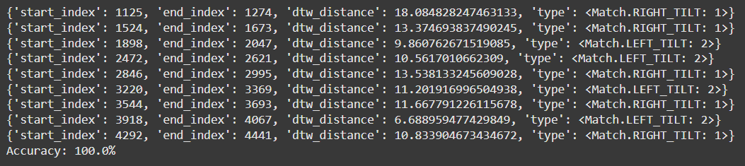
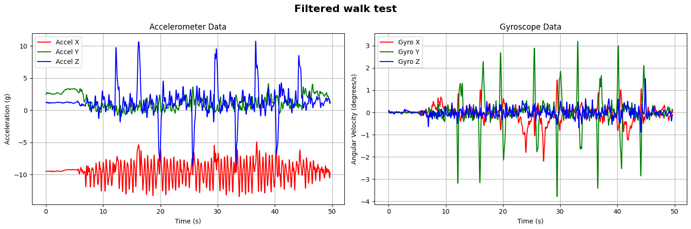
Left-right while walking

Slide 17
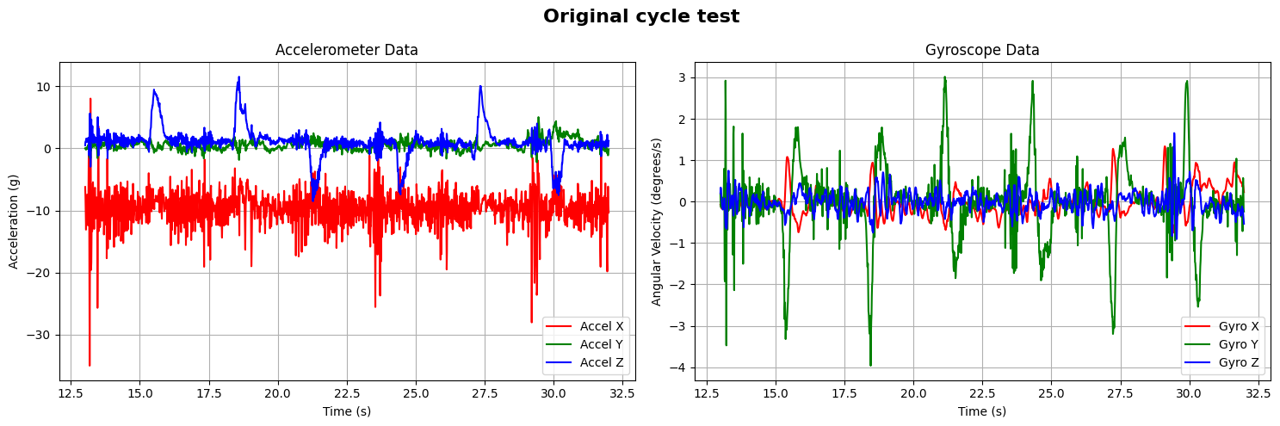
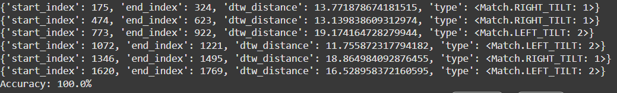
Left-right while cycling

Slide 18
Setup

Slide 19
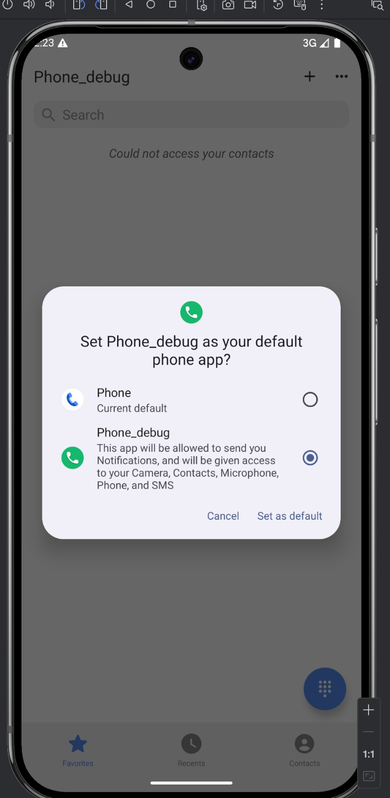
setup

Slide 20
setup

Slide 21
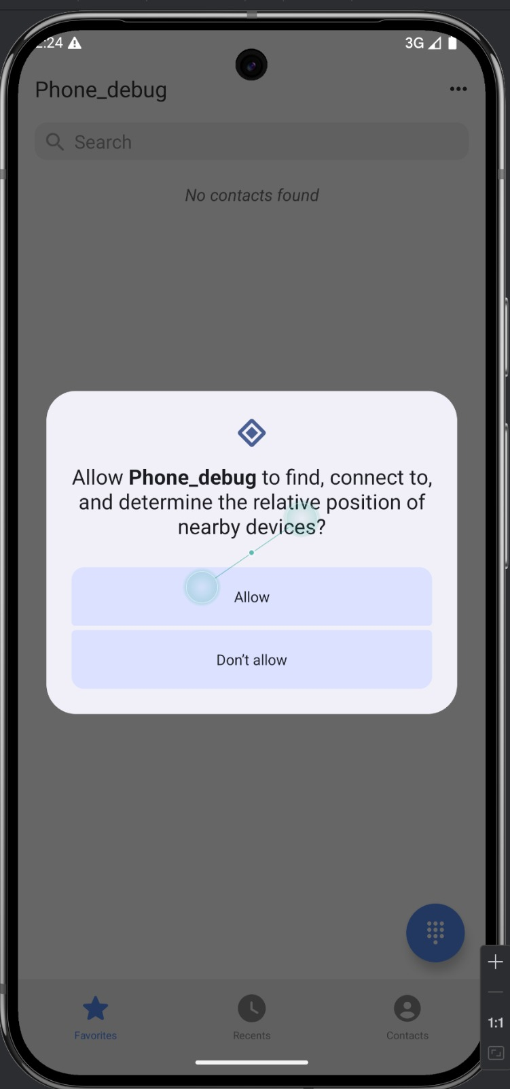
setup

Slide 22
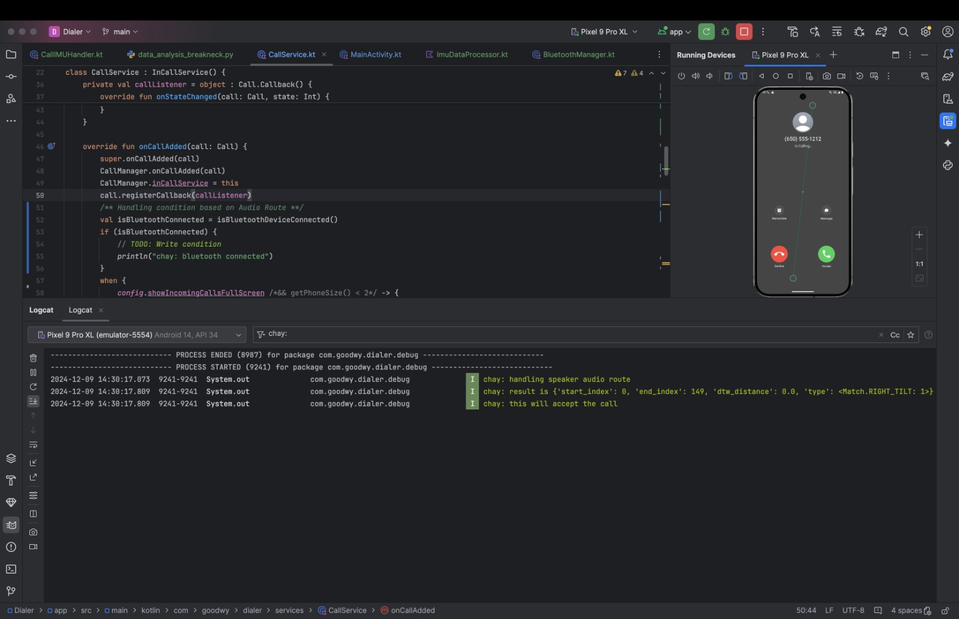
usage

Slide 23
usage

Slide 24
usage

Slide 25
usage

Slide 26
usage

Slide 27
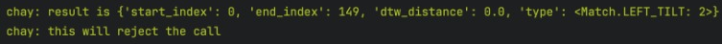
usage

Slide 28
usage

Slide 29
usage

Slide 30
Its that simple!

Slide 31
THANK YOU
Murtaza Mister
Eshwar Chaitanya Sarampati

